Slide 1

TASK RUNNER & SCSS
IN 30 MINUTES
Dikih Arif Wibowo – Kang Tata Rias Javan.

Slide 2




Task Runner?
#automator

Slide 3
CSS
* Compile SASS/SCSS into CSS
* Run Autoprefixer on the new CSS to catch any vendor
* Minify the prefixed CSS
JavaScript
* Check our javascript for error
* Concatenate other included scripts into one file
* Minify Script
Other Utilities
* Watch files for changes and rerun tasks as need
* Run BrowserSync for testing in multiple browser and devices at once.
Images
* Optimize any JPG, GIF, or PNG to make the file smaller

Slide 4
How to use?
https://github.com/dikiharifwibowo/task-runner

Slide 5
CSS VS SCSS
SCSS contains all the features of CSS and contains more features that are not present in CSS which makes it a good choice for developers to use it.
SCSS is full of advanced features
SCSS offers variable, nested, component and soon.

Slide 6
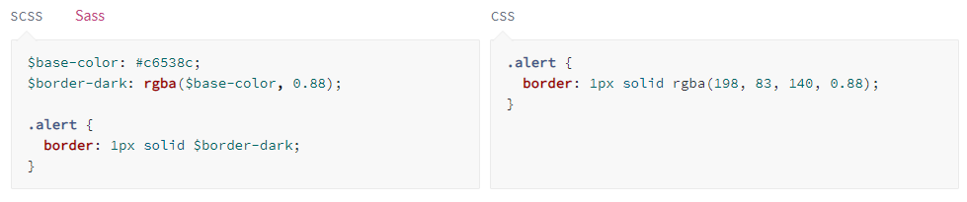
VARIABLES

Slide 7
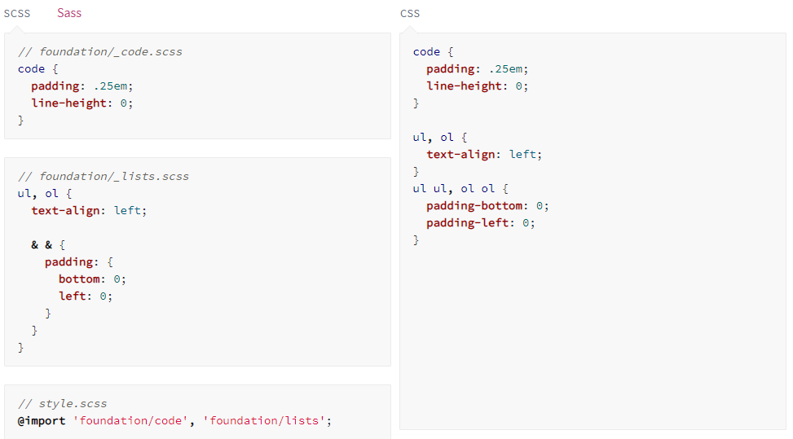
IMPORT or USE

Slide 8
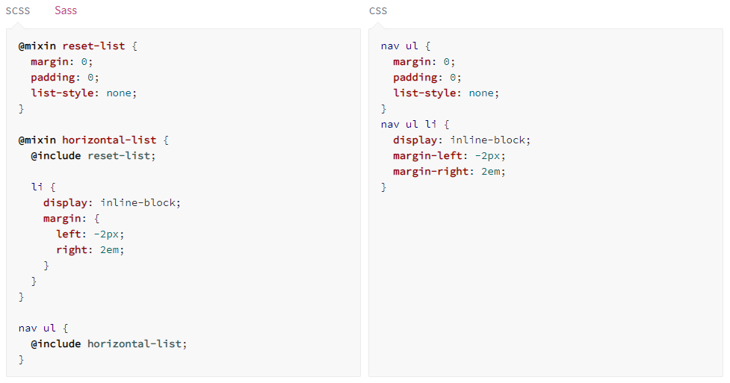
MIXIN & INCLUDE

Slide 9
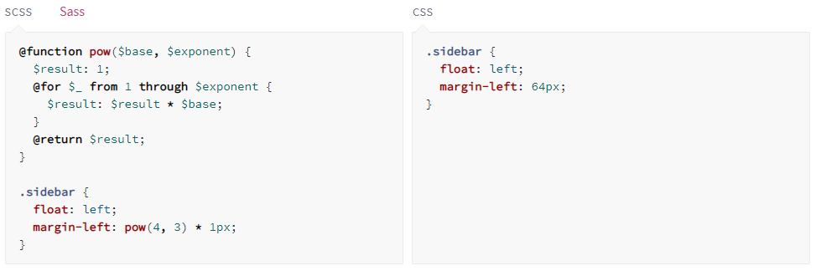
FUNCTION

Slide 10
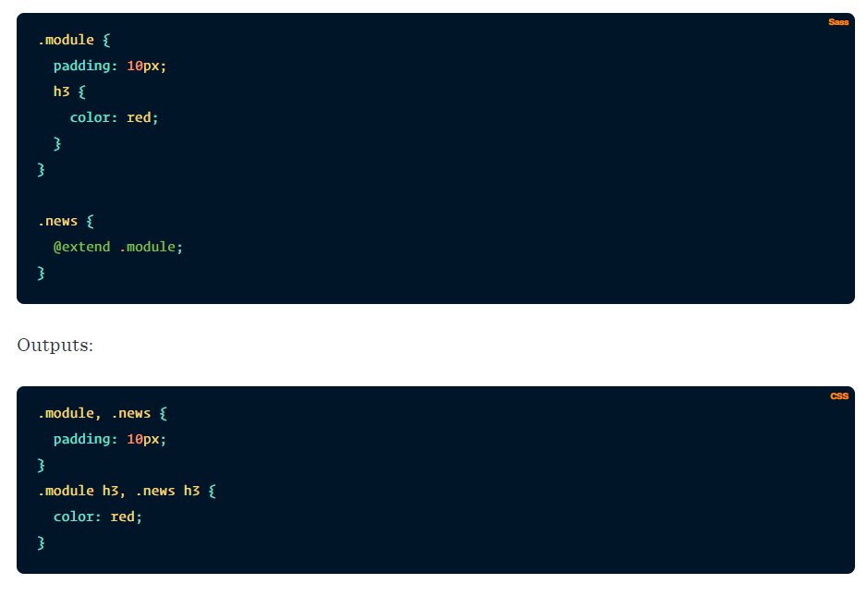
EXTEND

Slide 11
Let’s Code
Example : Project Bappeda Probolinggo

Slide 12


